Slide 1
Lecture 2: Data Manipulation
Intro to Data Science for Public Policy
Spring 2018
Jeff Chen

Slide 2
Roadmap
Homework #0
Motivating Story
Data Manipulation Concepts
Code-along
Intro to Data Science for Public Policy, Spring 2018

Slide 3
Motivation
$560.9 million
lawsuit payouts
New York City, 2011
Motivation

Slide 4
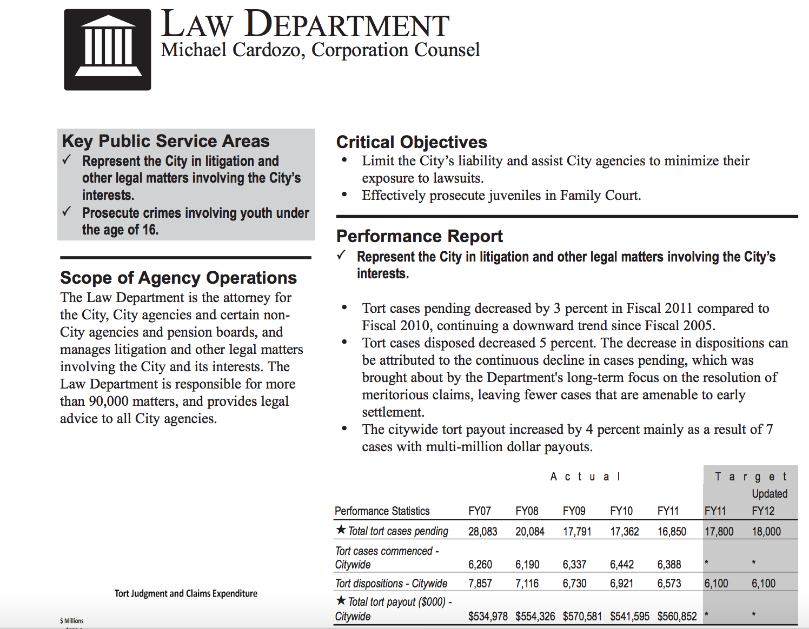

Slide 5
Old strategy
Settle for low and as quick as possible to clear the cases from the docket
Potential Policy Options
Continue current course
Ask lawyers to pick and choose cases to litigate
Use information to moneyball litigation
Motivation

Slide 6
Use information to moneyball litigation is the same as asking “which cases are winnable?” or otherwise stated:
Pr(win | case details)
Motivation
Notes:
Ask what goes into case details?
- Goal is to get class to name discrete features, but then make the point that data isn’t available in discrete features

Slide 7
Example (from similar but not exact data)
Table: Metadata
Doc: Summary and Notes
Logs: Activities
The cause of action for indemnification interposed against the manufacturer of an allegedly defective product is independent of the underlying wrong and for the purpose of the Statute of Limitations accrues when the loss is suffered by the party seeking indemnity. Hence, the dismissal of that part of the third-party complaint seeking indemnity, as barred by the four-year Statute of Limitations for breach of warranty measured from the date of tender of delivery (Uniform Commercial Code, § 2-725), was unwarranted. Plaintiff Joseph McDermott, an employee in the New York City Sanitation Department, commenced this action against the city in 1969 after his arm was severed by the hopper mechanism of a sanitation truck. The city, in turn, brought a third-party action in June, 1975 against respondent Heil Company, the manufacturer of the body and hopper of the truck. The city alleged that any injury to the plaintiff was caused solely by Heil's breach of duty, and demanded full indemnification. Specifically, the city claimed that the product was not fit for its intended use and was dangerous to those who used it. In addition, the third-party complaint asserted a claim for negligence. The trial evidence indicated that sanitation truck bearing serial number 252-386 was delivered to the city on February 5, 1969. On the evening of February 24, 1969, plaintiff and two fellow sanitation workers, Richard Mancuso and Joseph Cantelli, were assigned to that truck. When the accident occurred, Mancuso was driving, while McDermott and Cantelli were collecting refuse and loading it into the rear of the truck. Plaintiff testified that he was dumping the contents of a refuse can into the truck when the hopper activated. His arm got caught, he was raised up in the air, screaming, and his limb was severed. It is undisputed that the hopper mechanism was designed to activate only when a button at the rear of the truck was pressed. Both plaintiff and Cantelli related, however, that they did not activate the hopper, and it was impossible for Mancuso to have done so from the cab of the vehicle. Another city employee swore that, after the incident, he checked the hopper and it seemed to be functioning properly.
Case Name. -- Joseph McDermott v. City of N. Y., 50 N.Y.2d 211 (1980)
Case Date. May 1, 1980
Payout Amount: $150,000
Court: Court of Appeals of the State of New York
Other: Type of case, judge, lawyers
McDermott Case – Request for documents
McDermott Case – Five results submitted
McDermott Case – New questions submitted
McDermott Case – Requests reviewed
McDermott Case – New questions submitted
McDermott Case – Judge visit
McDermott Case – Discovery session
Source: https://www.ravellaw.com/opinions/2f75081b7aa9376053a07190a0a38559. Note that some data has been simulated.
Motivation
Notes:
Issue: Manual extraction of information is not an option when problems are voluminous

Slide 8
Example (from similar but not exact data)
Plaintiff
Plaintiff gender
Number of plaintiffs
Individual or corp
Respondent
Type of respondent
Table: Metadata
Case Name. -- Joseph McDermott v. City of N. Y., 50 N.Y.2d 211 (1980)
Case Date. May 1, 1980
Payout Amount: $150,000
Court: Court of Appeals of the State of New York
Other: Type of case, judge, lawyers
Age of case
Case load in year
Payout
Historical leaning of court
Past record for case type
Judge’s record on similar cases
Lawyer’s case load
Lawyer to judge interaction
Motivation
Notes:
Ask what goes into case details?
- Goal is to get class to name discrete features

Slide 9
Example (from similar but not exact data)
Doc: Summary and Notes
The cause of action for indemnification interposed against the manufacturer of an allegedly defective product is independent of the underlying wrong and for the purpose of the Statute of Limitations accrues when the loss is suffered by the party seeking indemnity. Hence, the dismissal of that part of the third-party complaint seeking indemnity, as barred by the four-year Statute of Limitations for breach of warranty measured from the date of tender of delivery (Uniform Commercial Code, § 2-725), was unwarranted. Plaintiff Joseph McDermott, an employee in the New York City Sanitation Department, commenced this action against the city in 1969 after his arm was severed by the hopper mechanism of a sanitation truck. The city, in turn, brought a third-party action in June, 1975 against respondent Heil Company, the manufacturer of the body and hopper of the truck. The city alleged that any injury to the plaintiff was caused solely by Heil's breach of duty, and demanded full indemnification. Specifically, the city claimed that the product was not fit for its intended use and was dangerous to those who used it. In addition, the third-party complaint asserted a claim for negligence. The trial evidence indicated that sanitation truck bearing serial number 252-386 was delivered to the city on February 5, 1969. On the evening of February 24, 1969, plaintiff and two fellow sanitation workers, Richard Mancuso and Joseph Cantelli, were assigned to that truck. When the accident occurred, Mancuso was driving, while McDermott and Cantelli were collecting refuse and loading it into the rear of the truck. Plaintiff testified that he was dumping the contents of a refuse can into the truck when the hopper activated. His arm got caught, he was raised up in the air, screaming, and his limb was severed. It is undisputed that the hopper mechanism was designed to activate only when a button at the rear of the truck was pressed. Both plaintiff and Cantelli related, however, that they did not activate the hopper, and it was impossible for Mancuso to have done so from the cab of the vehicle. Another city employee swore that, after the incident, he checked the hopper and it seemed to be functioning properly.
Indemnification sought
Statute of Limitations
Time lapse since event
Respondent detail
Type of employment
Potential misuse
Bodily injury
Disability
Third-parties
Witnesses
Motivation
Notes:
Ask what goes into case details?
- Goal is to get class to name discrete features

Slide 10
Example (from similar but not exact data)
Logs: Activities
McDermott Case – Request for documents
McDermott Case – Five results submitted
McDermott Case – New questions submitted
McDermott Case – Requests reviewed
McDermott Case – New questions submitted
McDermott Case – Judge visit
McDermott Case – Discovery session
Intensity of research
# of activities on case = 7
Types of activities
Motivation
Notes:
Ask what goes into case details?
- Goal is to get class to name discrete features

Slide 11
To turn the data into usable information, we need to standardize values, extract concise information, transform values, and merge it together.
Motivation

Slide 12
Roadmap
Motivating Story
Data Manipulation Concepts
Code-along
Intro to Data Science for Public Policy, Spring 2018

Slide 13
Extract-Transform-Load (ETL)
Data is almost never provided in clean, usable form. ETL is the process that makes data usable.
Extract = obtain data from a database or multiple database of consistent or variable formats
Transform = data is transformed into a usable format for either storage, analysis or other use
Load = the output of the transform stage gets loaded into a database, software, or algorithm for use
ETL Overview
Notes:
Effectiveness should never make someone look bad (i.e. don’t make the lawyer look dumb)
Query, get info from, do something to data, and load it back into server
For example, get an extraction query
Apply manipulation to get it into the appropriate form
Apply algorithm by loading it back into the system

Slide 14
Extract-Transform-Load (ETL)
Extract
Transform
Load
Subset
Value
Clean
Reformat
De-dupe
Extract information
Structural
Subset
Order
Collapse
Reshape
Merge
Data Manipulation
Notes:
Experiment design helps you determine your sampling frame

Slide 15
Extract/Subset
Data manipulation: Structural
Exercise!
Data Manipulation

Slide 16
Reformat/Clean
Data manipulation: Value
Standardization of values – get values to be consistent
Reformatting variables
Data Manipulation

Slide 17
Cleansing: Example
What’s wrong with this vector?
salary <- c("$100k ","$10,000","None")
Data Manipulation

Slide 18
Cleansing
Cleansing: Example
What’s wrong with this vector?
salary <- c("$100k ","$10,000","None")
Remove $
Replace k with 000
Remove $
Replace with NA
Convert to numeric
Data Manipulation

Slide 19
Cleansing
Cleansing: Example
What’s wrong with this vector?
salary <- c("$100k ","$10,000","None")
gsub()
as.numeric()
Data Manipulation
Notes:
gsub is used for replacing values

Slide 20
Cleansing
Cleansing: Example
gsub("[pattern]", "[new pattern]", obj)
gsub() = “find and replace”
Pattern and new pattern are the find and replace text respectively
obj is an R-object
Data Manipulation

Slide 21
Cleansing
Cleansing: Example
salary <- c("$100k ","$10,000","None")
salary <- gsub("k", "000", salary)
salary <- gsub("None", NA, salary)
How do we remove $?
Data Manipulation

Slide 22
Cleansing
Cleansing: Example
salary <- c("$100k ","$10,000","None")
salary <- gsub("k", "000", salary)
salary <- gsub("None", NA, salary)
How do we remove $ and comma?
gsub("[[:punct:]]","", salary)
gsub("[$,]","", salary)
Data Manipulation

Slide 23
Cleansing: Strings & RegEx
String methods. Functions designed to manipulate and work with string values.
gsub("[[:punct:]]","", salary)
Regular Expressions (RegEx). Special characters that represent string patterns
Data Manipulation

Slide 24
Cleansing: Strings & RegEx
String methods. Functions designed to manipulate and work with string values.
grep()
gsub()
regexpr()
substr()
regmatches()
trimws()
tolower()
Returns index position for matched pattern.
Find and replace string.
Returns character position of match.
Extracts values based on character positions.
Extracts matched pattern.
Removes white space around strings.
Converts all characters to lower case.
Data Manipulation
Notes:
Set of functions that can apply pattern identification.
Grep() returns all the rows that return something

Slide 25
Cleansing: String methods
#examples
x <- c("Where's waldo?","Not here")
grep("waldo",x)
regexpr("waldo",x)
substr(x, 8,14)
regmatches(x,regexpr("waldo",x))
gsub("Not here", "...found him!",x)
Data Manipulation

Slide 26
Cleansing: RegEx
Extended character classes for R
Positions
^
$
Beginning of string
End of string
[[:punct:]]
[[:alpha:]] or [a-zA-Z]
[[:digit:]] or \\d
[[:alnum:]] or [a-zA-Z0-9]
[[:space:]] or \\s
\\w
\\W
punctuation
alphabetic
numbers
alphanumeric
spaces
word characters
Not word
Examples of escaped characters
\\.
\\$
\\"
period
dollar sign
quotation mark
Quantifiers
More on this at: https://stat.ethz.ch/R-manual/R-devel/library/base/html/regex.html
*
{n}
Wildcard, match at least 0
Match pattern n times
Data Manipulation

Slide 27
Cleansing: String methods
#Censor the phone number and the time
a <- ”Please call me at 212-353-4213 at 12pm"
Data Manipulation
Notes:
Easy to build a simple expression and then make exceptions to it.

Slide 28
De-duplication
Data manipulation
De-duplication ensures that certain records are not over-represented.
Ensures more accurate count of unique records and minimizes erroneous ‘cartesian product’ matches during merging
Data Manipulation

Slide 29
De-Dupe Method
duplicated(obj)
Accepts an R-object (e.g. dataframe, vector), returns boolean vector indicating if a record is a duplicate.
#example
vec <- c(1, 2, 3, 4, 1, 2, 3, 4)
duplicated(vec)
vec[!duplicated(vec)]
Data Manipulation

Slide 30
Parsing
Data manipulation
Data can be stored in nested formats:
a <- "1,2,4,10"
And data that is delimited in any way can be parsed:
b <- "duck, duck, goose"
c <- "The Dow is up!"
Data Manipulation

Slide 31
Parsing
strsplit(x, delim)
unlist(x)
Splits string based on delimiter.
Converts list object into vectors.
#Convert following into three column matrix
b <- "duck, duck, goose"
c <- strsplit(b, ",")
matrix(trimws(unlist(c)), nrow=1, byrow=T)
Data Manipulation

Slide 32
Parsing: Example
#Convert following into three column matrix
b <- "duck, duck, goose"
c <- strsplit(b, ",")
matrix(trimws(unlist(c)), nrow=1, byrow=T)
Data Manipulation

Slide 33
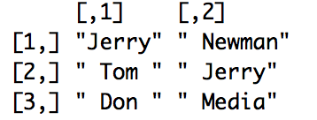
Parsing: Exercise
#Epic battles: Parse into two column matrix
case <- c( "Jerry v. Newman", " Tom vs. Jerry", " Donald versus Media")
Goal →
Hint: clean up delimiter first
Data Manipulation

Slide 34
Parsing: Exercise - Answer
case <- c( "Jerry v. Newman", " Tom vs. Jerry",
" Don versus Media")
case <- gsub("vs\\.| v\\.", "versus",case)
b <- strsplit(case,"versus")
matrix(unlist(b), nrow=3, byrow=T)
Data Manipulation

Slide 35
Reshape
Data manipulation
Tabular data often is found in one of two formats:
Long form
Wide
Loc_id | Type | Value
1 | Lat | -40.72
1 | Lon | 50.1
2 | Lat | -43.5
2 | Lon | 52.45
Loc_id | Lat | Lon
1 | -40.72 | 50.1
2 | -43.5 | 52.45
Data Manipulation
Notes:
Long: All columns except for one act in combination with others. Only one specific ID.
Wide: (Use for data analysis) we stretch variables across the top and each row has unique identifier.

Slide 36
Reshape
Data manipulation
Tabular data often is found in one of two formats:
Long form
Wide
Loc_id | Type | Value
1 | Lat | -40.72
1 | Lon | 50.1
2 | Lat | -43.5
2 | Lon | 52.45
Loc_id | Lat | Lon
1 | -40.72 | 50.1
2 | -43.5 | 52.45
Data Manipulation

Slide 37
Reshape: Example Uses
Long form
Panel series
Compact data storage
Server Logs
Sensor recordings
Wide form
Satellite imagery
Economic time series
Most tabular analysis-ready data
Data Manipulation

Slide 38
Reshape: Long vs. Wide
x <- data.frame( id = c(1,1,2,2),
t = c(1,2,1,2), income = c(50,55,101,123),
vote = c(8,7,4,3))
wide <- reshape(x,
idvar="id",
timevar="t",
direction="wide")
Data Manipulation

Slide 39
Reshape: Wide to Long (simple case)
#simple case
long <- reshape( wide,
idvar = "id",
timevar = "t",
direction = "long")
Data Manipulation

Slide 40
Reshape: Wide to Long (complex)
#complex case
wide <- data.frame( id = c(1,2,3),
income = rnorm(3,100,5),
debt = rnorm(3,-10,20))
long <- reshape(wide,
varying = c("income", "debt"),
v.names = "amount",
timevar = "financials",
time = c("income", "debt"),
direction = "long")
Data Manipulation

Slide 41
Collapse/Aggregate
Data manipulation
Collapse methods convert raw transactional data into summaries of discrete units
Aggregates = summary stats by some group identifier
Data Manipulation

Slide 42
Collapse: Example Uses
Often times more signal in aggregates and patterns begin to emerge
Uber rides → Calculate number of uber rides by origin and destination
Call center logs → Call volume by hour, day, type for staff planning
Legal documents → Frequency of word combinations that are associated with themes or issues
Data Manipulation

Slide 43
Collapse
aggregate(obj, by = list(x), FUN = fun)
Key
obj = an R object like a data frame
by = group by or list of variables to be
FUN = a statistical function (e.g. mean,
Data Manipulation

Slide 44
Collapse: Example
x <- data.frame(var1 = round(rnorm(100,1000,100)),
group1 = round(runif(100)*5))
aggregate(x$var1, by = list(x$group1), FUN = length)
aggregate(x$var1, by = list(x$group1), FUN = summary)
Data Manipulation

Slide 45
Merges / Joins
Combine two or more data using common attributes
Data manipulation
Why joining is necessary?
Tables are often “normalized” – data is stored in separate tables to reduce redundancy
Allows for identifying commonalities and gaps
Practical cases:
What is the market conversion rate in a twitter campaign?
Add variables to improve predictions
Data Manipulation

Slide 46
Service User
ID Name
1 James
2 Jane
3 John
4 Jana
5 Jorgenson
6 Janette
Tax Returns
ReturnID ID Year Income
1 1 2010 $100,000
21 1 2011 $100,000
34 1 2012 $90,000
300 2 2011 $90,000
405 2 2013 $96,000
1524 2 2014 $100,000
Each table has a ‘primary key’, which is a column or combination of columns that uniquely identifies a given row
Marital Status
MarID ID Year Status
142 1 2010 Married
4 2 1990 Married
30 3 2009 Single
531 3 2012 Married
953 3 2013 Divorce

Slide 47
Service User
ID
Name
Tax Returns
ReturnID
ID
Year
Income
Data is joined on keys.
When joining data together, the data receiving the join (often times the ‘left handside dataset’), the key in that dataset is known as the ‘primary key’. All other keys (right handside) are ‘foreign keys’
Marital Status
MarID
ID
Year
Status

Slide 48
Dataset 1
Dataset 2
Referred to as “A”, “X”, or “left”
Referred to as “B”, “Y” or “right”
Datasets
Records

Slide 49
Types of Joins/Merges
Table-level
Record-level
Dataset 1
Dataset 2
Dataset 1
Dataset 2
Left [Outer] Join
A U (A ∩ B)
Right [Outer] Join
B U (A ∩ B)
1:1
Dataset 1
Dataset 2
Dataset 1
Dataset 2
Inner Join
Intersection = A ∩ B
[Full] Outer Join
Union = A U B
1:m
Notes:
LOJ -> Keep everything in lefthand and show the details in right that overlap with left
ROJ -> Same but flip to righthand
Inner join is most common -> Intersection between two sets
Outer join is useful for missing data
If there is many duplicates on both sides, then that is a many to many match. (Not what you want)

Slide 50
merge()
merge(df1, df2,
by = c("match_var"),
all.x = T, all.y = F)
Key
df1 = data frame #1
df2 = data frame #2
by = vector of column names to be used for matching
all.x = boolean to keep all df1
all.y = boolean to keep all df2
Data Manipulation

Slide 51
What should the merge command be if the merge variable is “id”?
Dataset 1
Dataset 2
Dataset 1
Dataset 2
[ ]
[ ]
[ ]
Dataset 1
Dataset 2
Dataset 1
Dataset 2
[ ]
[ ]
[ ]
Notes:
Not specifying means they are both false.

Slide 52
What should the merge command be if the merge variable is “id”?
1:1 and 1:m are not dependent on merge but deduplication
Dataset 1
Dataset 2
Dataset 1
Dataset 2
merge(df1, df2, by = “id”, all.x = T)
merge(df1, df2, by = “id”, all.y = T)
Any
Dataset 1
Dataset 2
Dataset 1
Dataset 2
merge(df1, df2, by = “id”)
merge(df1, df2, by = “id”, all.x = T, all.y = T)
Any

Slide 53
Merges: Universes and backbones
Merges are only as good as the completeness of records of the underlying tables. Need ‘complete frame’ or universe to get full picture
Ex: Missing days in these two sequences
days1 <- data.frame(time = c( 1, 2, 3, 10, 11, 12, 20), flag1 = c(1))
days2 <- data.frame(time = c( 1, 2, 4, 8, 9, 10, 12, 21), flag2 = c(1))
Merge

Slide 54
Merges: Universes and backbones
Why gaps matter:
Knowledge of reliability of data collection
Ability to score data across the whole potential universe rather than the known universe
Merge

Slide 55
Merges: Universes and backbones
Backbone = the most expansive known list of potential records
days1 <- data.frame(time = c( 1, 2, 3, 10, 11, 12, 20),flag1 = c(1))
days2 <- data.frame(time = c( 1, 2, 4, 8, 9, 10, 12, 21),flag2 = c(1))
df <- data.frame(time = seq(1,21, 1))
df <- merge(df, days1, by="time", all.x=T)
df <- merge(df, days2, by="time", all.x=T)
Merge

Slide 56
Merges: Universes and backbones
time flag1 flag2
1 1 1
2 1 1
3 1 NA
4 NA 1
5 NA NA
6 NA NA
7 NA NA
8 NA 1
Merge
Notes:
How do you do data merging efficiently?
Are the things you are merging on uniquely identified on both datasets?
If you don’t de-duplicate and can’t be neatly identified when bringing together, the number of combinations will be fucking huge.
With recursive merging, remove data frames as you go along

Slide 57
Roadmap
Motivating Story
Data Manipulation Concepts
Code-along
SOTU data cleansing
Intro to Data Science for Public Policy, Spring 2018

Slide 58
To Do For Next Class
Review Lecture 3 at: https://georgetownmccourt.github.io/data-science/
Homework #1 will be available via Blackboard
Assignments
Notes:
Will need to do everything we did in today (1/22) class. Thursday office hours for Chen.
Control limits is basically slapping a SD of 3 around the mean and then flagging things that exceed it. We’ll do this to flag days and specific cities that have more crime than usual.
See what records get flagged. We’re giving him the code and giving it to him. We’ll then run it.

